Slide 1
Difference-in-Difference
Elizabeth Tipton
NSF Improving Education R&D Evaluations Workshop
2021

Slide 2
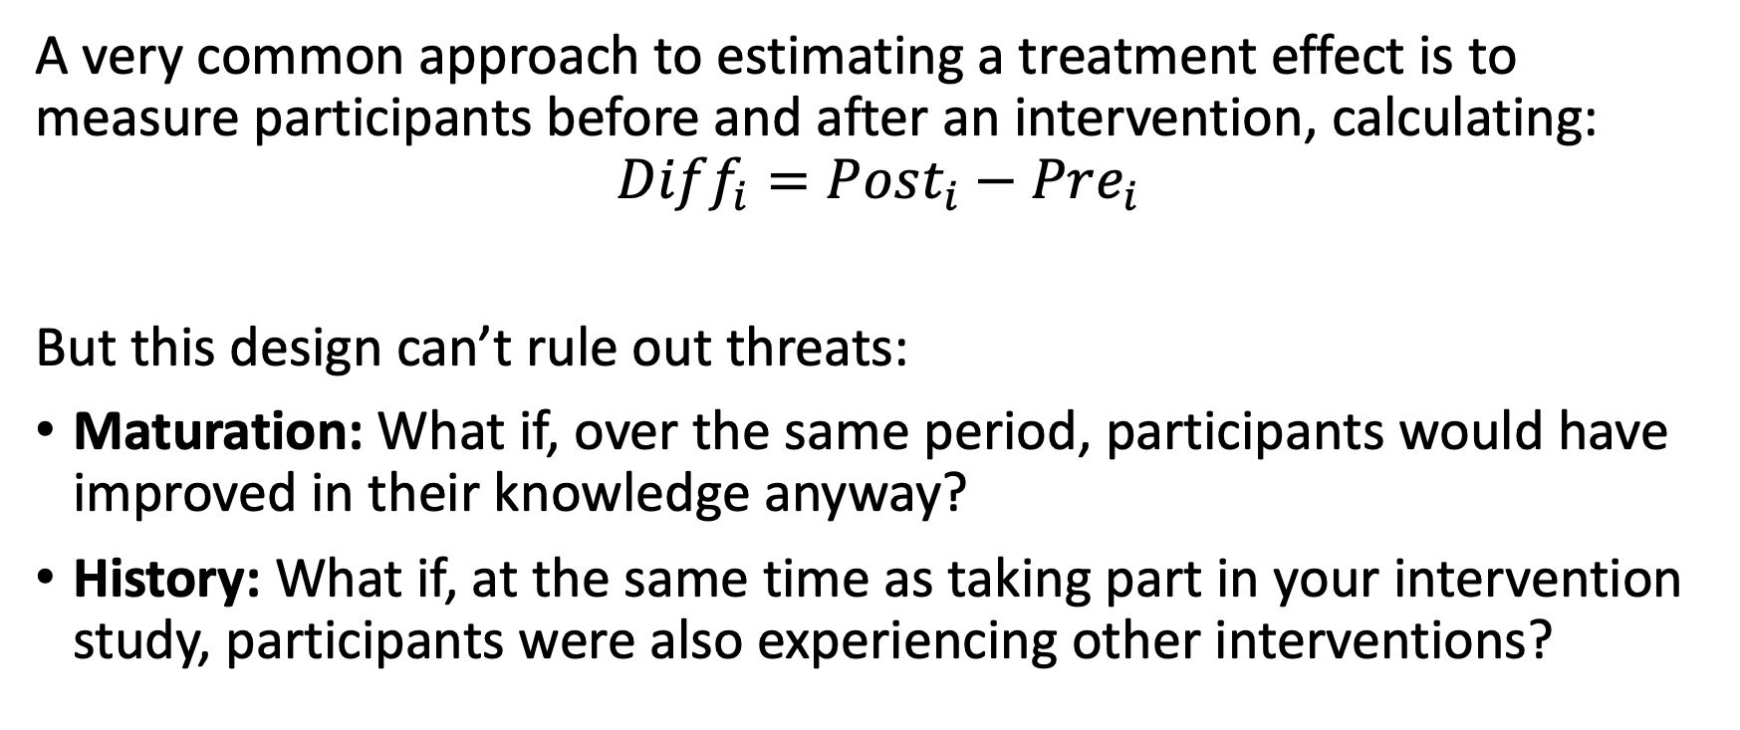
Pre-Post Problems
A very common approach to estimating a treatment effect is to measure participants before and after an intervention, calculating:
$$Diff_{i}=Post_{i}−Pre_{i}$$
But this design can’t rule out threats:
Maturation: What if, over the same period, participants would have improved in their knowledge anyway?
History: What if, at the same time as taking part in your intervention study, participants were also experiencing other interventions?

Slide 3
A deeper problem
This can be confusing: I see that participants have large gain scores, so what do you mean that isn’t “caused” by the intervention?
Remember that the causal effect, however, is about potential outcomes. It is not about the effect you observe, but about what would have happened in the absence of this intervention.
The causal effect is inherently about comparing two versions of reality.

Slide 4
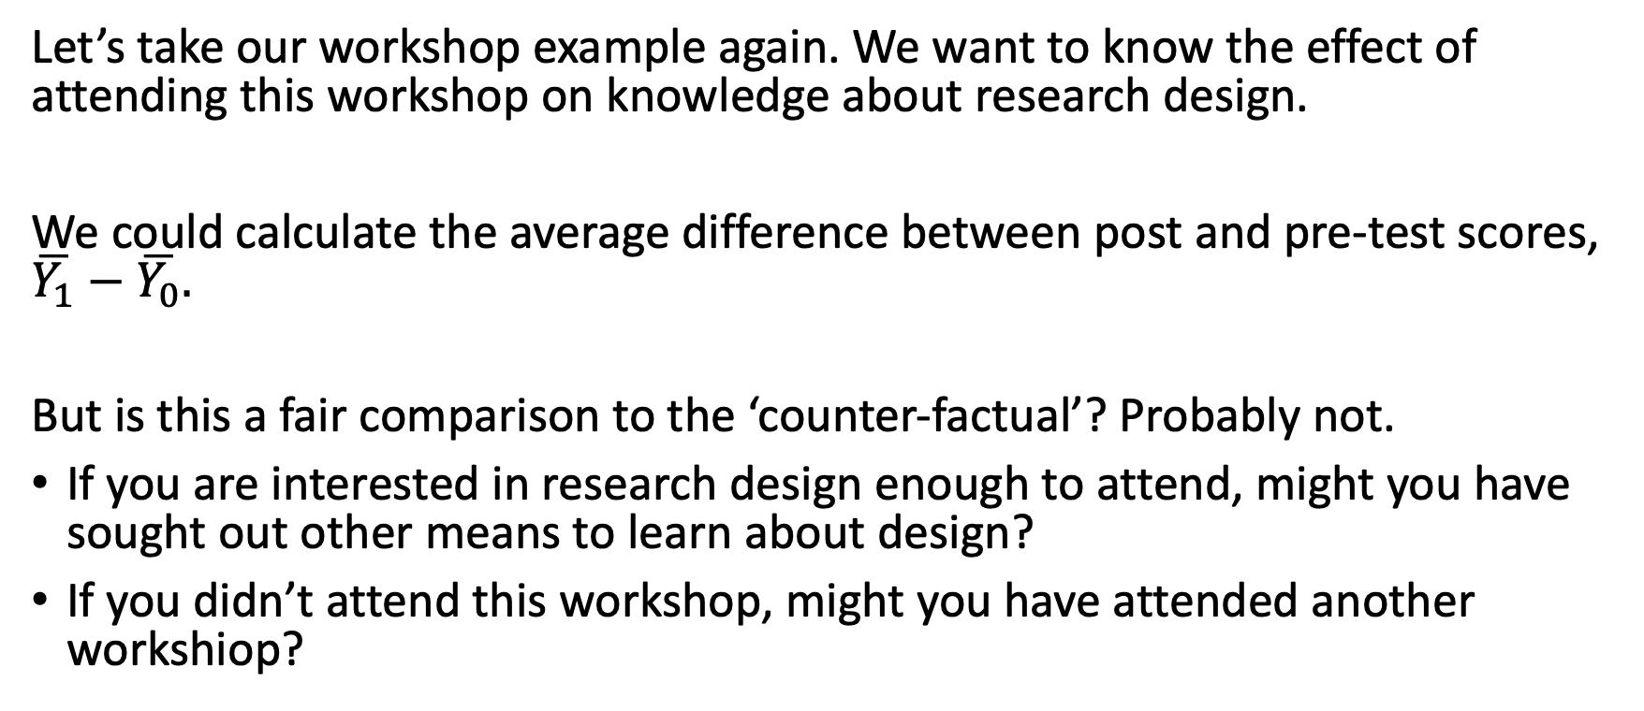
Example
Let’s take our workshop example again. We want to know the effect of attending this workshop on knowledge about research design.
We could calculate the average difference between post and pre-test scores, $\overline{Y_{1}}−\overline{Y_{0}}.$
But is this a fair comparison to the ‘counter-factual’? Probably not.
If you are interested in research design enough to attend, might you have sought out other means to learn about design?
If you didn’t attend this workshop, might you have attended another workshiop?

Slide 5
Statistical Model

Slide 6
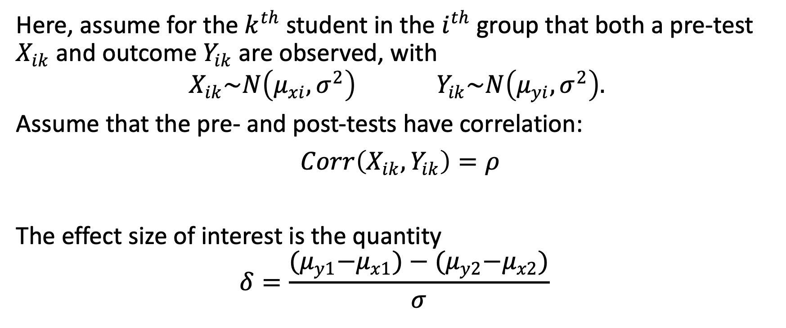
Model
Here, assume for the $k^{th}$ student in the $i^{th}$ group that both a pre-test $X_{ik}$ and outcome $Y_{ik}$ are observed, with
$$X_{ik}\sim N\left(μ_{xi},σ^{2}\right) Y_{ik}\sim N\left(μ_{yi},σ^{2}\right).$$
Assume that the pre- and post-tests have correlation:
$Corr\left(X_{ik},Y_{ik}\right)=ρ$
The effect size of interest is the quantity
$$δ=\frac{{(μ}_{y1}−μ_{x1})−{(μ}_{y2}−μ_{x2})}{σ}$$

Slide 7
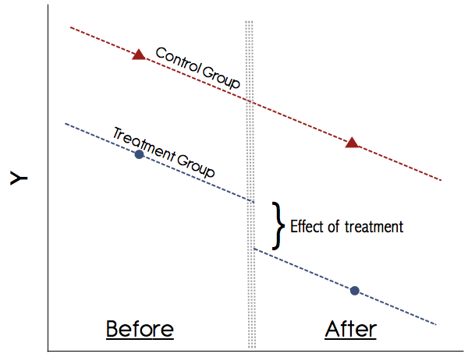

Slide 8
How does this work?
Main idea: Without the intervention, the two groups would have the same slope over the full range of time
We are assuming:
in both groups
the relationship between time (X) and the outcome (Y)
is linear
and these lines are parallel
This allows us to extrapolate what would have happened in the treatment group if there was no intervention.

Slide 9
Parallel Trends Assumption
In words, we are assuming that in the absence of the intervention,
The two groups are changing at the same rate over time
The slopes of their growth trajectories over time are the same
We are using the growth trajectory in the comparison group to provide ‘counter-factual’ information on that the growth trajectory would have been in the intervention group, if there were no intervention.

Slide 10
Common Shocks Assumption
In this design, the comparison condition is not explicitly required to be identical to the intervention condition.
However, the comparison group can only control for other intervening causes if it experiences the same intervening causes experienced by the intervention group.
This means we assume that the intervention and comparison groups experience the same ”shocks” (other causes, other interventions) between pretest and posttest

Slide 11
Statistical Analysis

Slide 12
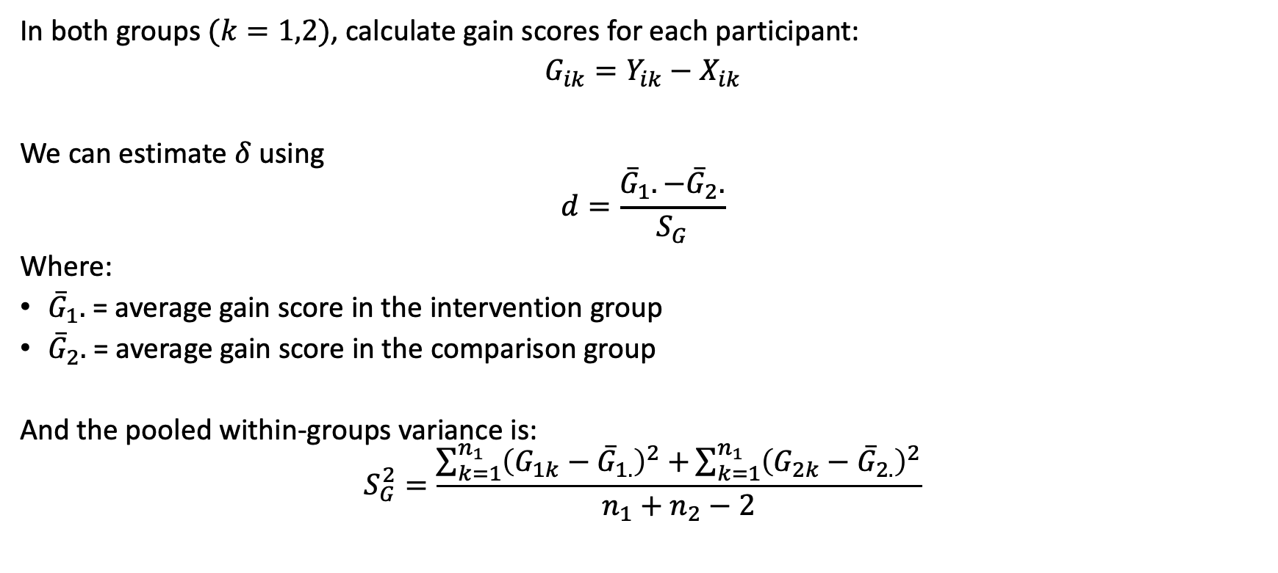
Gain Scores
In both groups $(k=1,2)$, calculate gain scores for each participant:
$G_{ik}=Y_{ik}−X_{ik}$
We can estimate $δ$ using
$$d=\frac{{\overline{G}}_{1}.−{\overline{G}}_{2}.}{S_{G}}$$
Where:
${\overline{G}}_{1}.$ = average gain score in the intervention group
${\overline{G}}_{2}.$ = average gain score in the comparison group
And the pooled within-groups variance is:
$$S_{G}^{2}=\frac{\sum_{k=1}^{n_{1}}{{\left(G_{1k}−{\overline{G}}_{1.}\right)}^{2}+}\sum_{k=1}^{n_{1}}{{\left(G_{2k}−{\overline{G}}_{2.}\right)}^{2}}}{n_{1}+n_{2}−2}$$

Slide 13
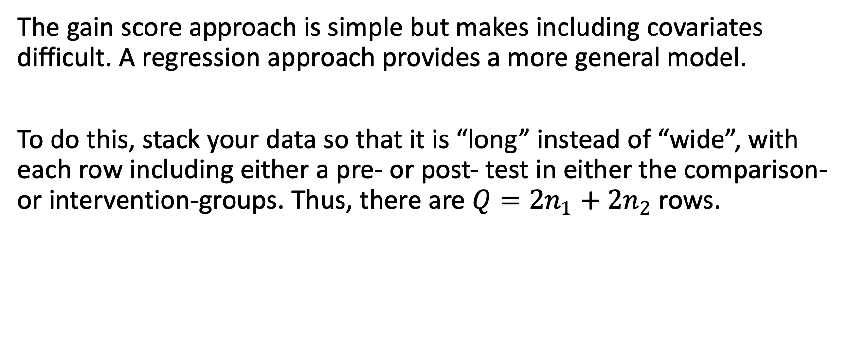
Regression
The gain score approach is simple but makes including covariates difficult. A regression approach provides a more general model.
To do this, stack your data so that it is “long” instead of “wide”, with each row including either a pre- or post- test in either the comparison- or intervention-groups. Thus, there are $Q=2n_{1}+2n_{2}$ rows.

Slide 14
Observation | Person | Measure | TRT | POST
1 | 1 | 10 | 0 | 0
2 | 1 | 8 | 0 | 1
3 | 2 | 5 | 0 | 0
4 | 2 | 8 | 0 | 1
5 | 3 | 2 | 0 | 0
6 | 3 | 12 | 0 | 1
7 | 4 | 7 | 1 | 0
8 | 4 | 5 | 1 | 1
9 | 5 | 3 | 1 | 0
10 | 5 | 3 | 1 | 1
11 | 6 | 9 | 1 | 0
12 | 6 | 10 | 1 | 1

Slide 15
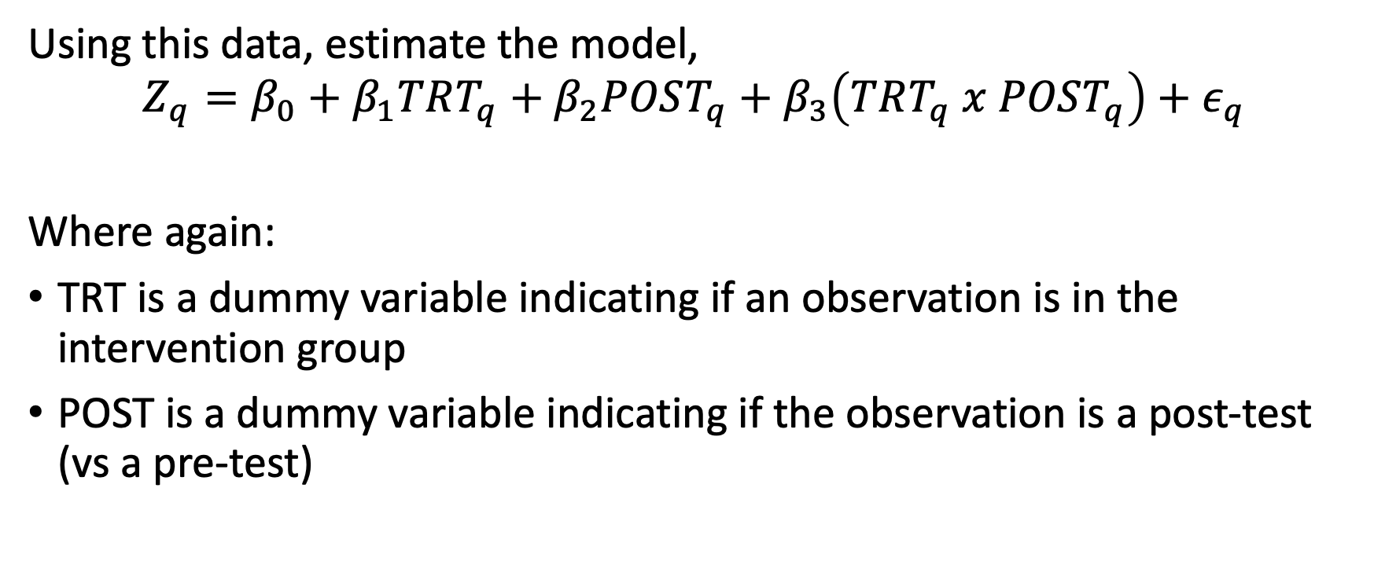
Estimation
Using this data, estimate the model,
$$Z_{q}=β_{0}+β_{1}TRT_{q}+β_{2}POST_{q}+β_{3}\left(TRT_{q} x POST_{q}\right)+ε_{q}$$
Where again:
TRT is a dummy variable indicating if an observation is in the intervention group
POST is a dummy variable indicating if the observation is a post-test (vs a pre-test)

Slide 16
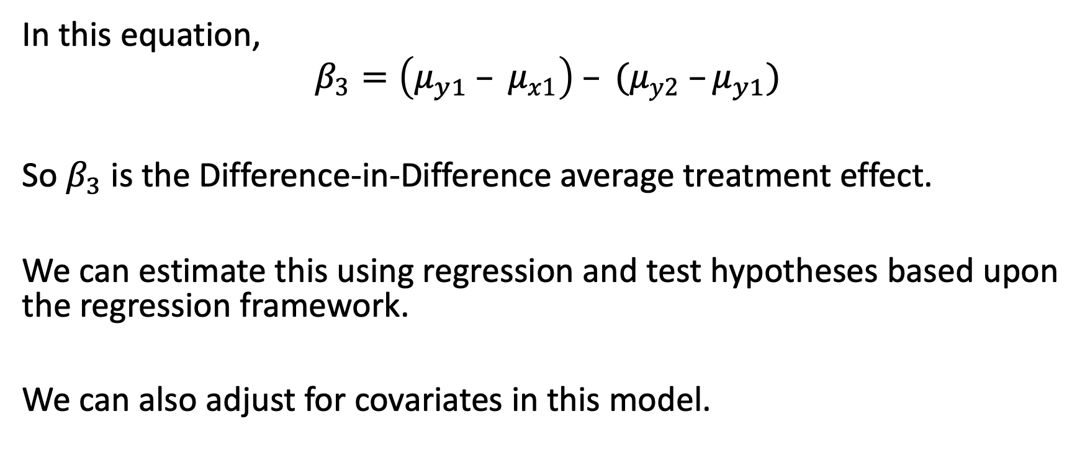
Diff-in-Diff regression coefficient
In this equation,
$$β_{3}=\left(μ_{y1} – μ_{x1}\right) – (μ_{y2} –μ_{y1})$$
So $β_{3}$ is the Difference-in-Difference average treatment effect.
We can estimate this using regression and test hypotheses based upon the regression framework.
We can also adjust for covariates in this model.

Slide 17
Verification of Assumptions
Neither of these two assumptions is easy to verify.

Slide 18
Parallel trends verification
Determining the growth trajectories of each group would require assessments of the outcome variable at many (or at least several) points in time.
It may be impossible or infeasible to administer more than two such tests (the pretest and the posttest).
Strategies:
If possible, then include additional measures for a (randomly selected) subset of students.
Use extant data on growth trajectories (e.g., in ECLS)
Clearly state the assumptions and any evidence you have, or don’t have

Slide 19
Common Shocks Verification
While it is difficult to know that all possible variables that could constitute shocks have been measured, it is possible to measure *some* of these.
Strategies:
Measure a variety of variables that might constitute shocks in both groups and
Determine whether the mean values of those variables are similar in the two groups (the logic is similar to matching).

Slide 20
Design Sensitivity

Slide 21
Design parameters
Statistical power for this design is a function of:
Intervention group sample size
Comparison group sample size
Effect size
Correlation between pre- and post-test

Slide 22
(something here exploring sensitivity)

Slide 23
Strategies to Increase Design Sensitivity

Slide 24
Unequal group sizes
Just as with randomized studies, there may be reasons why it is easier to collect data in the intervention group or comparison group.
For example:
The intervention may need to be small, but there is administrative data that can be used for the comparison group (which is much larger)
Schools are only willing to participate if most classes get the intervention – thus a smaller fraction is available for the comparison

Slide 25
Something here exploring sensitivity with unequal sizes

Slide 26
Using covariates
When using the regression approach, covariates can be included. These offer two benefits:
They improve the internal validity of the design, as they lead to groups that are more similar (on observed covariates), thus ruling out other possible explanations (e.g., selection)
They improve statistical conclusion validity, by improving sensitivity. Including covariates reduces the residual variation, thus improving power.

Slide 27
(something here showing how covariates help)

Slide 28
Planning a DiD Study

Slide 29
What do you need?
At a minimum, you will need an:
Intervention group
Comparison group
Pre- and post- test measure
Ideally, you will also have:
Measures of other potential causes (“shocks”) experienced in the two groups
Measures at additional time-points (for at least a random subset)
Covariates correlated with the outcomes

Slide 30
Selecting a comparison group
Your ideal comparison group is somewhat like your intervention group. For example:
A different grade in the same school
Another, similar school in the same district
They don’t have to be identical, but you should have reason to expect that their growth trajectories would be parallel and that they would experience similar ‘shocks’.

Slide 31
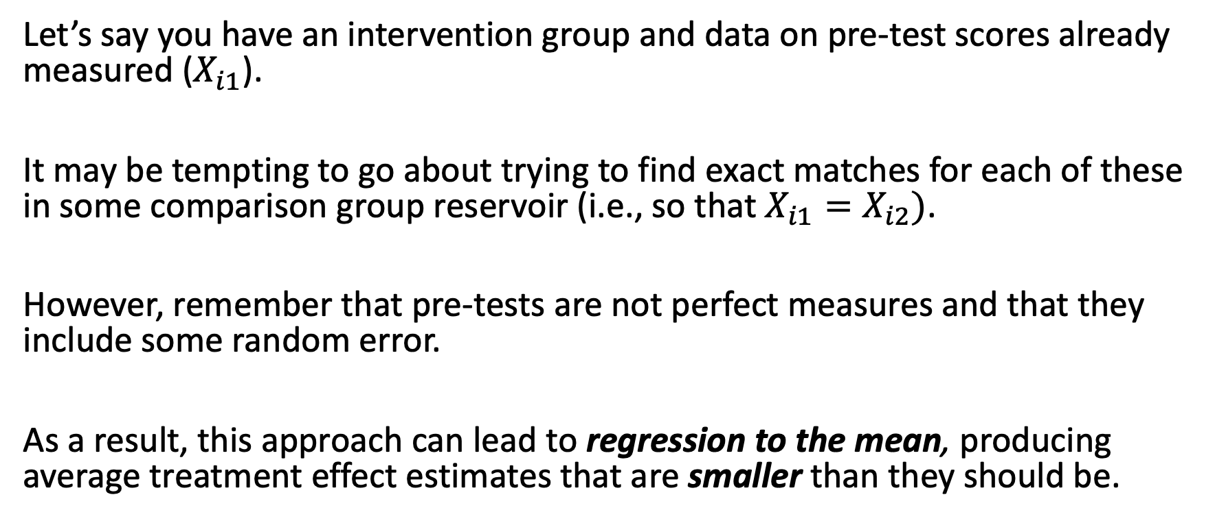
Be careful about regression effects
Let’s say you have an intervention group and data on pre-test scores already measured ($X_{i1}$).
It may be tempting to go about trying to find exact matches for each of these in some comparison group reservoir (i.e., so that $X_{i1}=X_{i2})$.
However, remember that pre-tests are not perfect measures and that they include some random error.
As a result, this approach can lead to regression to the mean, producing average treatment effect estimates that are smaller than they should be.

